Slide 1


Power Plant Study Visit – Upper Tamakoshi Hydropower
Presented By:
Bhupesh Jaishi (078BEL026)
Binod Kumar Sah (078BEL030)
Bishal Chaurasiya (078BEL031)
Chandan Sah (078BEL032)
Chandan Chaurasiya (078BEL033)
Deepak Yadav (078BEL036)
Divyanshu Mishra (078BEL039)
Kartik Kumar Sah (078BEL046)
Department of Electrical Engineering, IOE Pulchowk Campus
2025/06/13

Slide 2
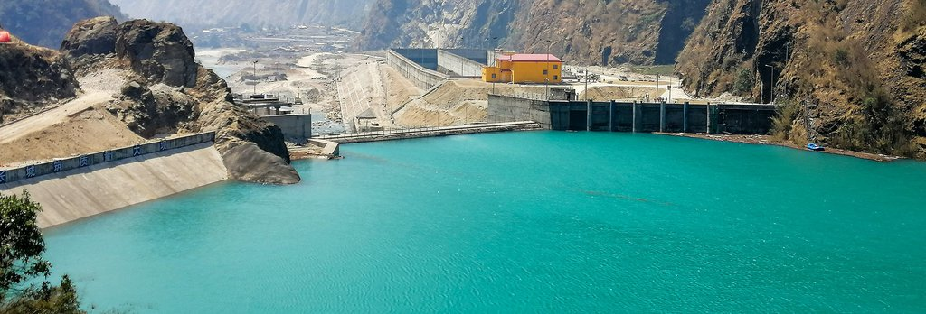
Upper Tamakoshi Hydropower plant: 456 MW

Slide 3
Overview
Type: Peaking Run-off River
Installed Capacity: 456 MW (6 units with 76 MW each)
Average annual energy after outage: 2281 GWh
Transmission line: (11/230KV) From Power house (Gongar) to New Khimti Substation.
Construction Period: 8 Years

Slide 4
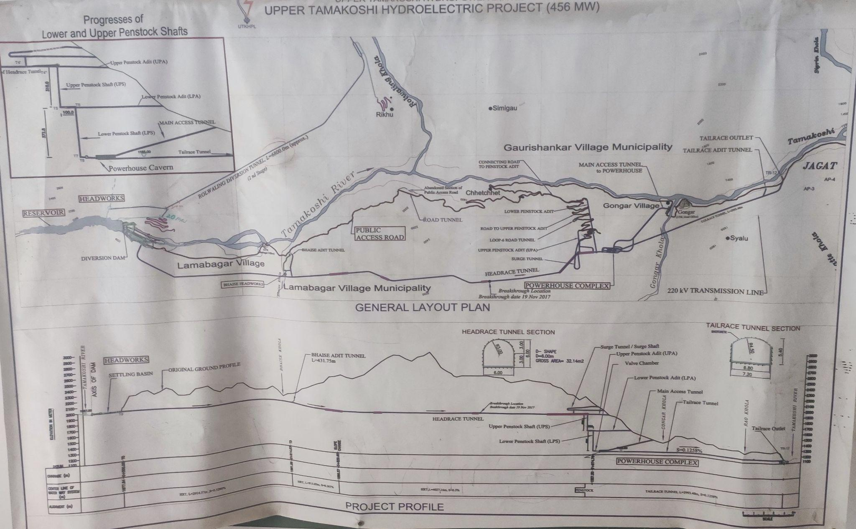
Overall Plant Overview

Slide 5
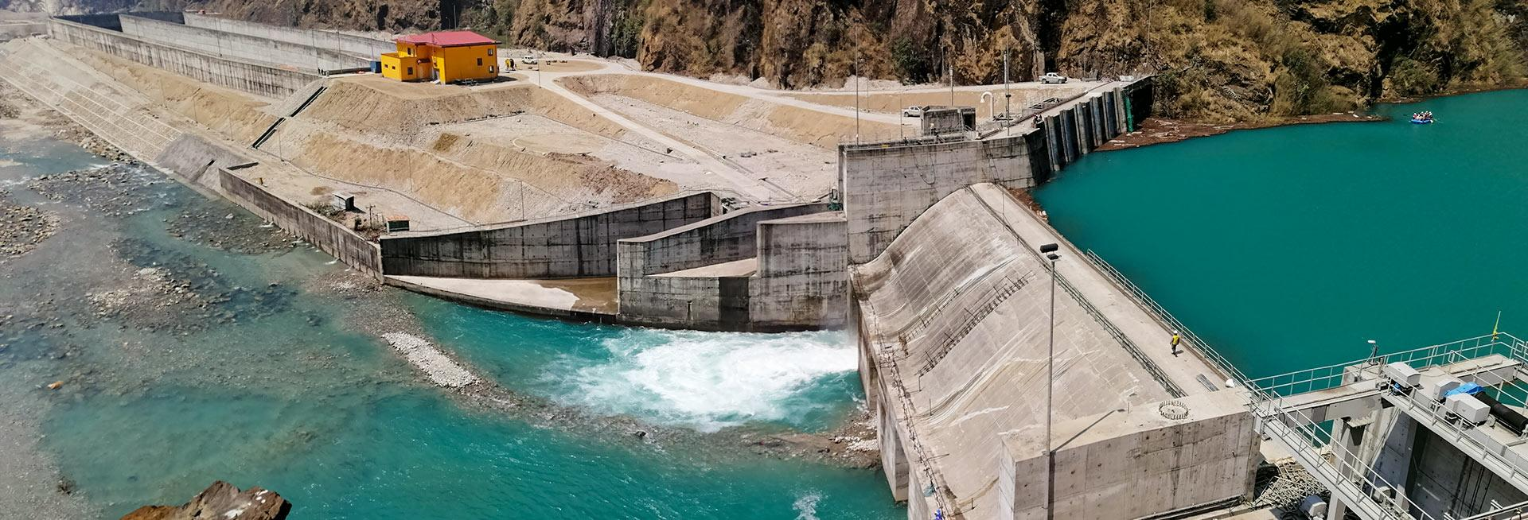
Reservoir and Dam Details:

Slide 6
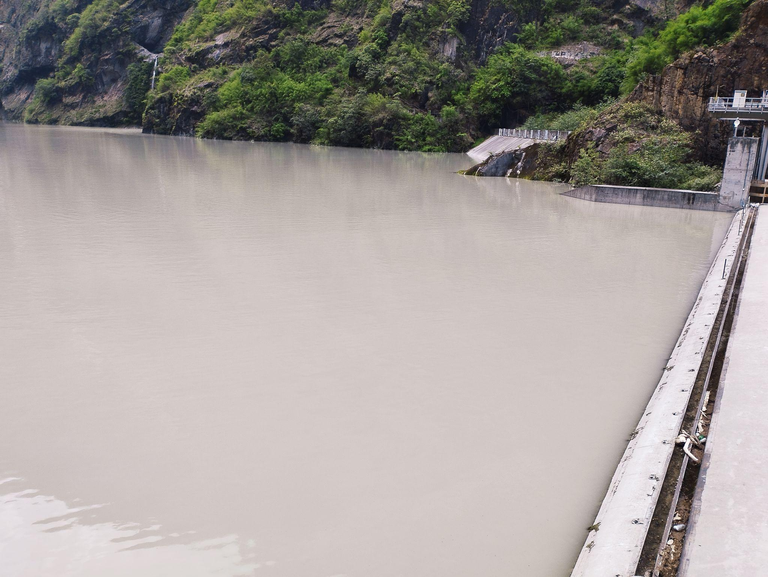
Reservoir Details:
Type: Run-of-river with a small daily-peaking live
storage (pondage).
Live Storage Capacity: 1.2 million cubic meter.
Dam Dimensions: 22 m high × 60 m long concrete
diversion dam
Gross Hydraulic Head: Approximately 822 m
Design Discharge: 66 m³/s
Riparian Release: 1.45 m³ /s
(policy to release minimum flow downstream to sustain aquatic ecosystem and support local water use.)

Slide 7
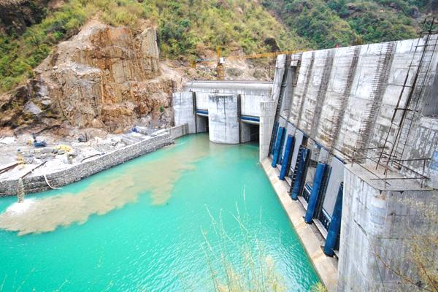
Dam:
Type: Run‑of‑river concrete diversion dam
Height: 22 m
Length (crest): 60 m
Number of Gates: 4 gated spillway
Location: Bigu Rural Municipality, Lamabagar

Slide 8
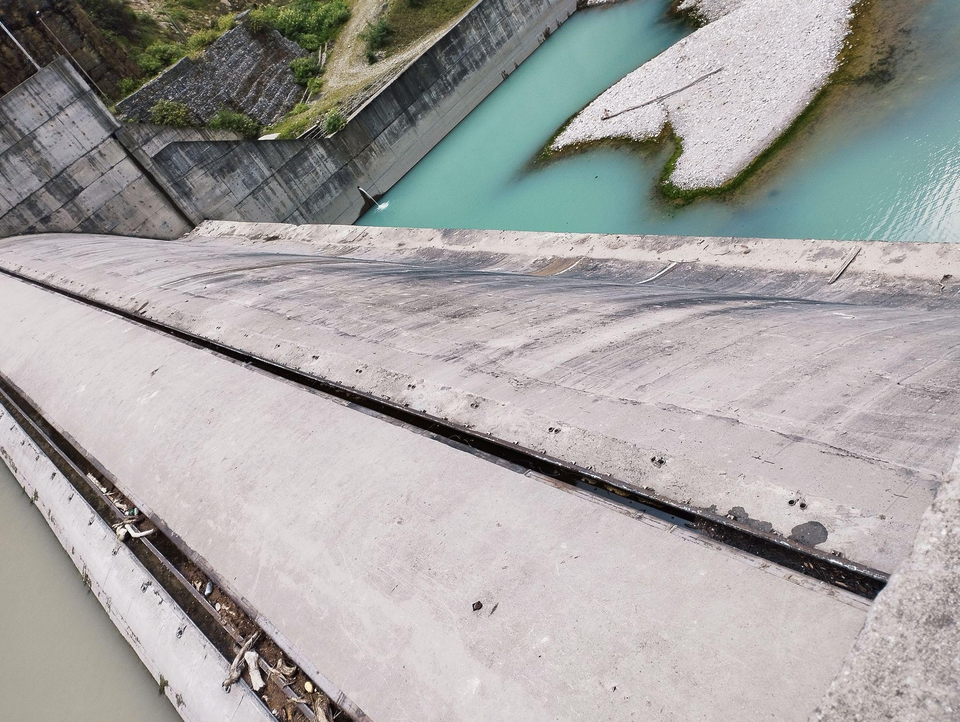
Spillway

Slide 9
Trash Rack:
Trash rack is equipped with diversion dam to prevent large debris (logs, branches, sediment, etc.) from entering the intake and damaging the turbines and other mechanical components from damage.
Manual cleaning after a certain period is done to prevent clogging, especially during monsoon season as it reduces water flow, lowering power generation.

Slide 10
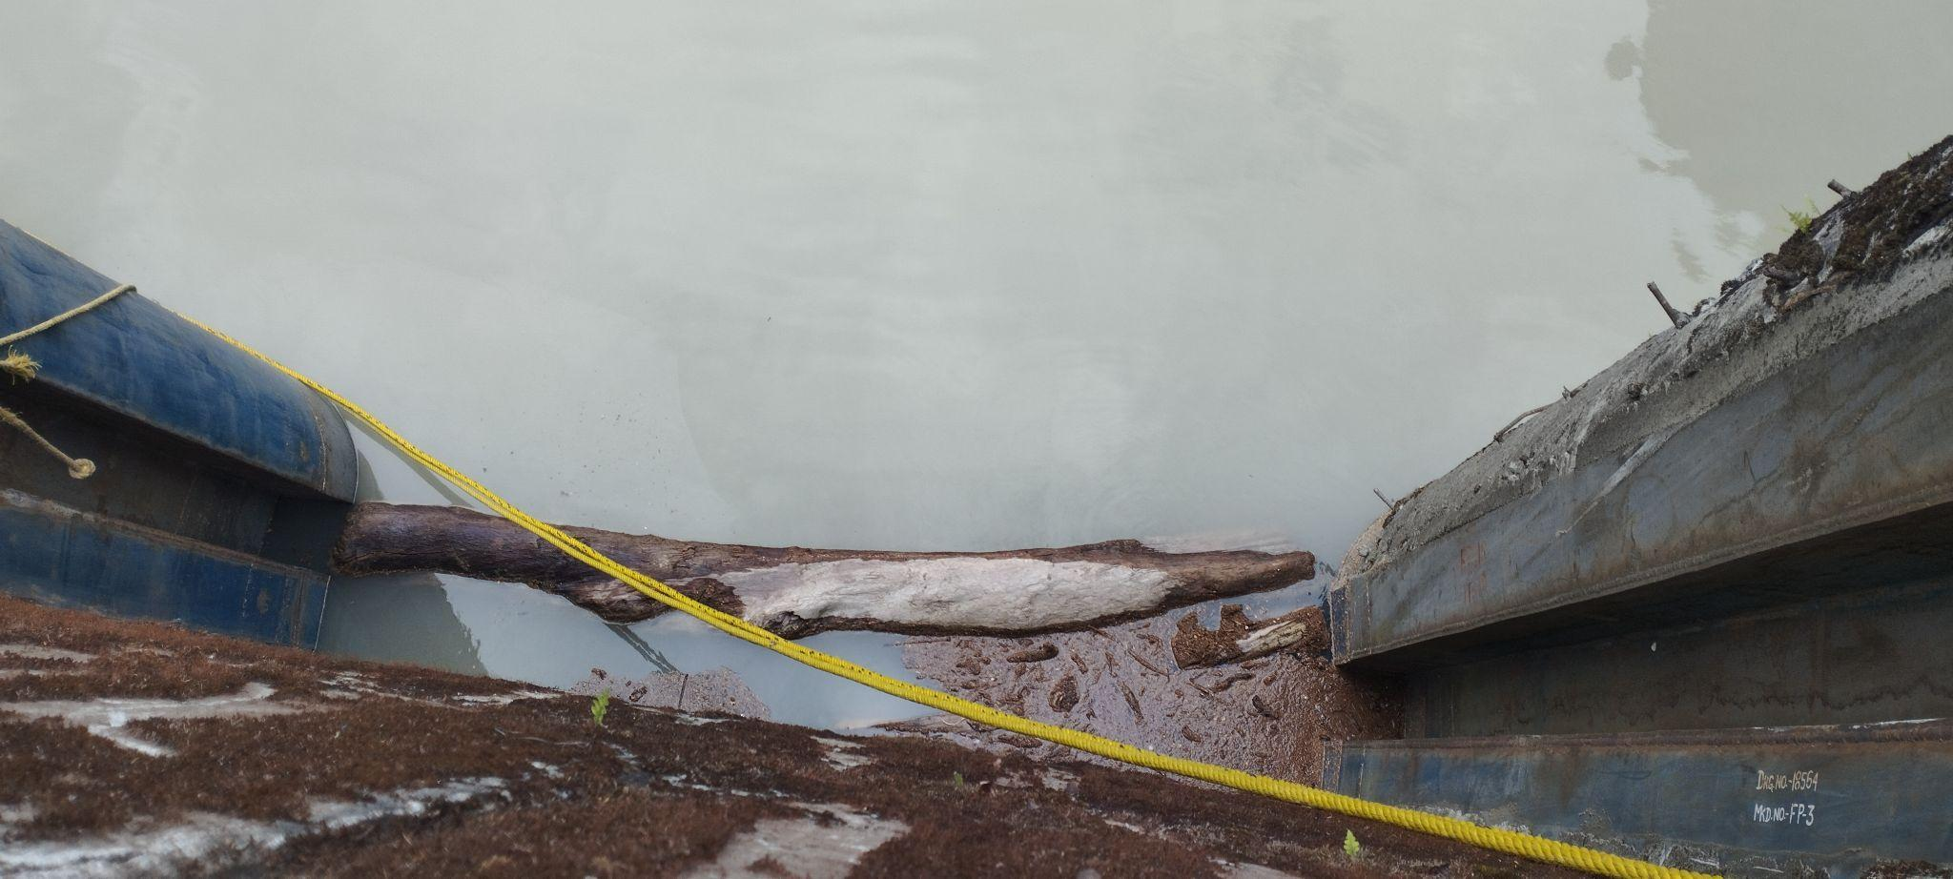
Trash rack

Slide 11
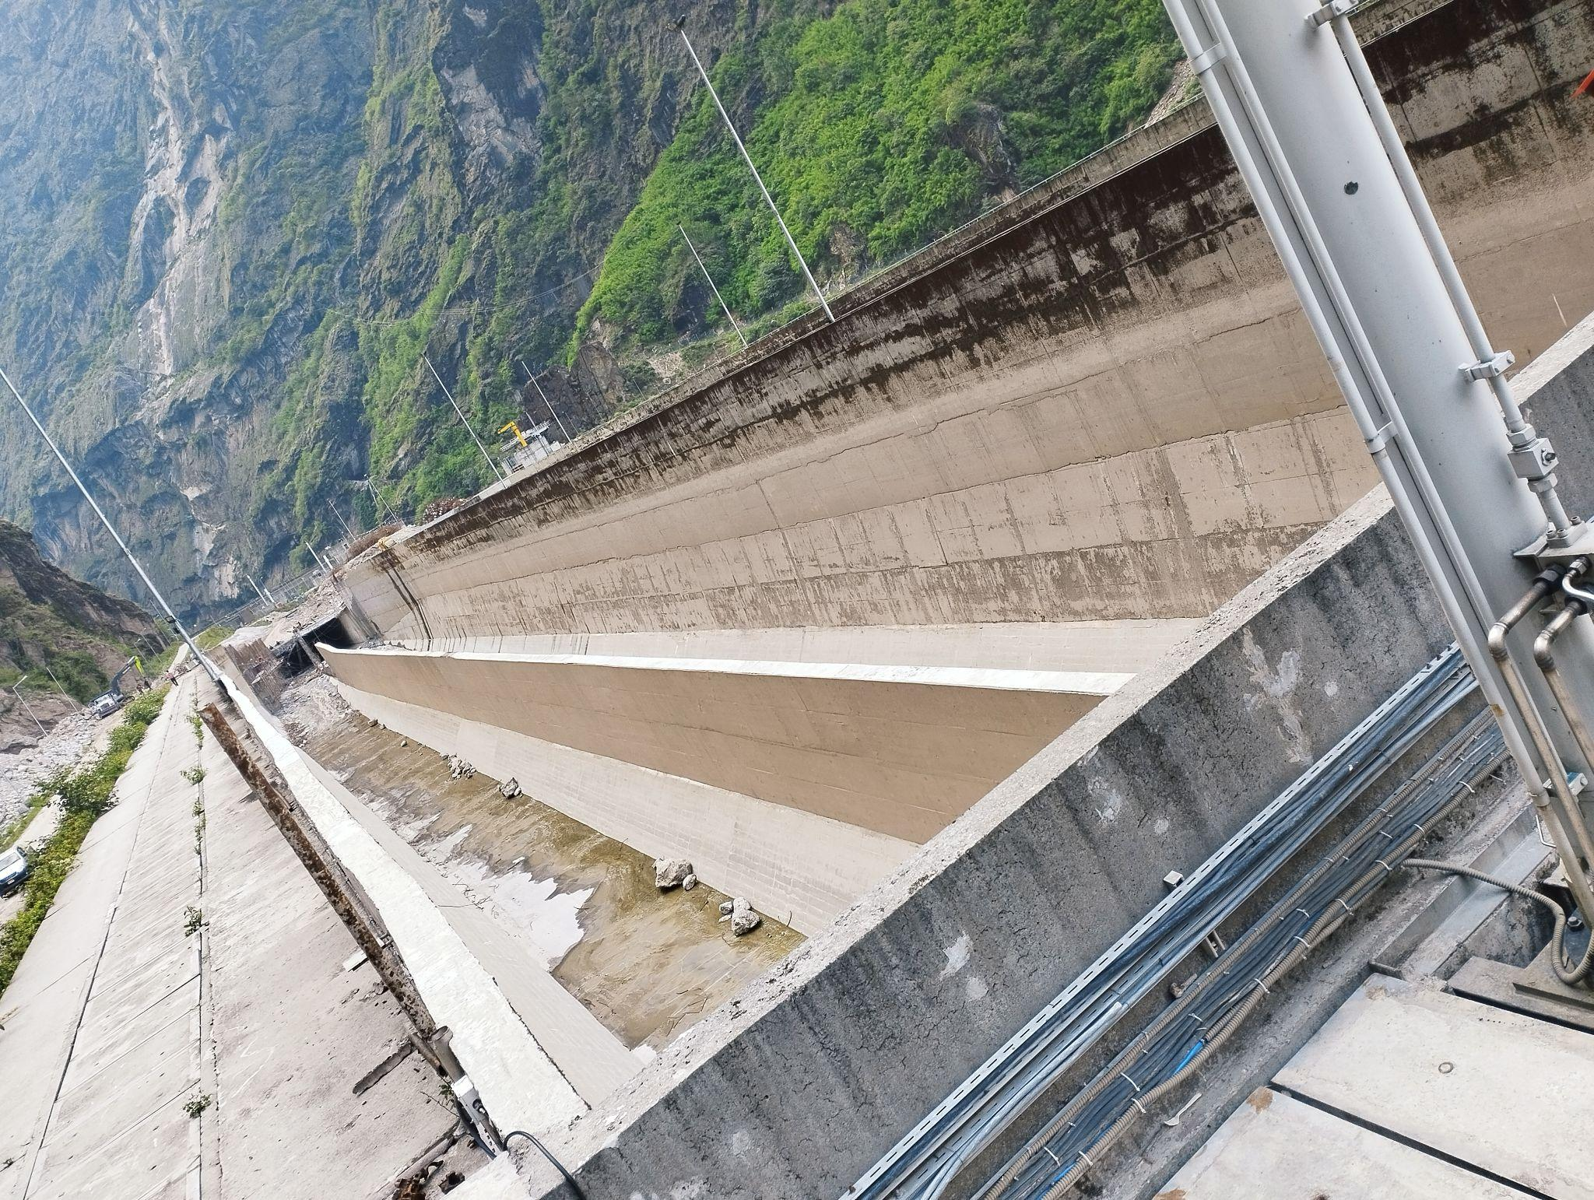
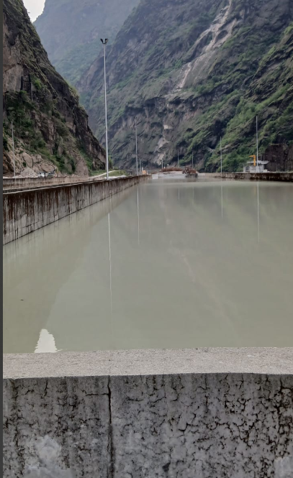
Settling Basin And Forebay:
Number of Settling Basin: 2
Dimension (L*B*H): (225*26*17.7)m
Due to landslide the settling basin on the left side of the image got damaged.
The plant is working with one settling basin.
The forebay at the end of the settling basin allow the water into headrace tunnel.

Slide 12
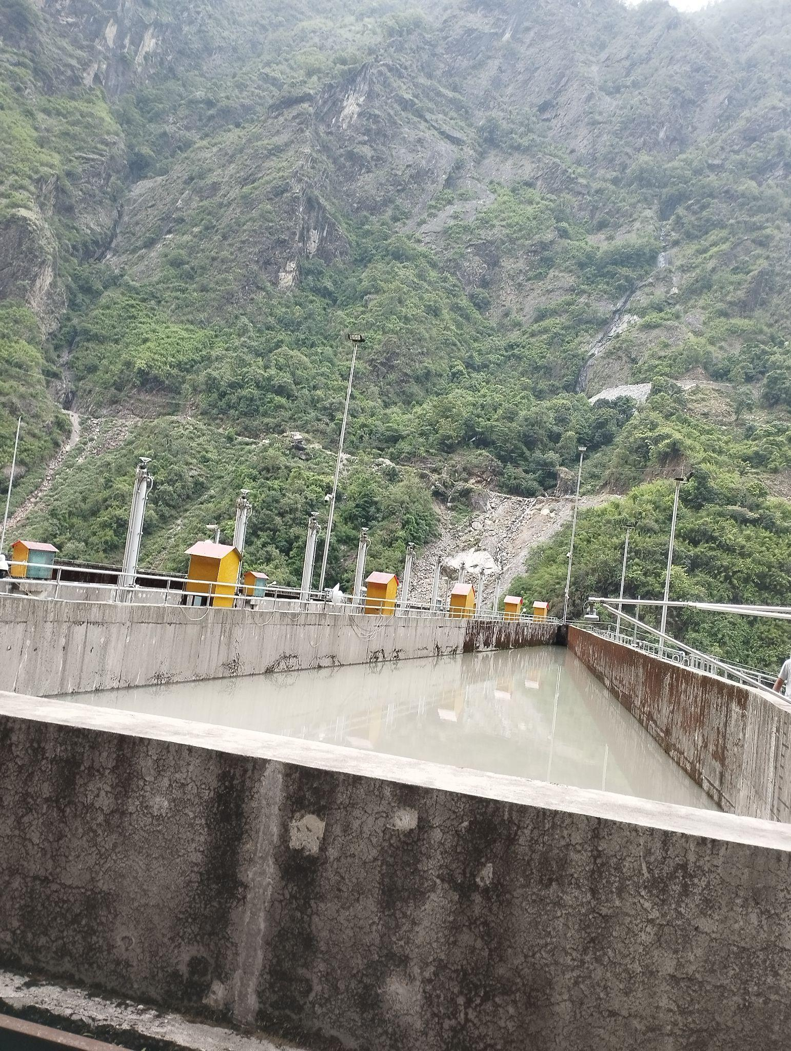
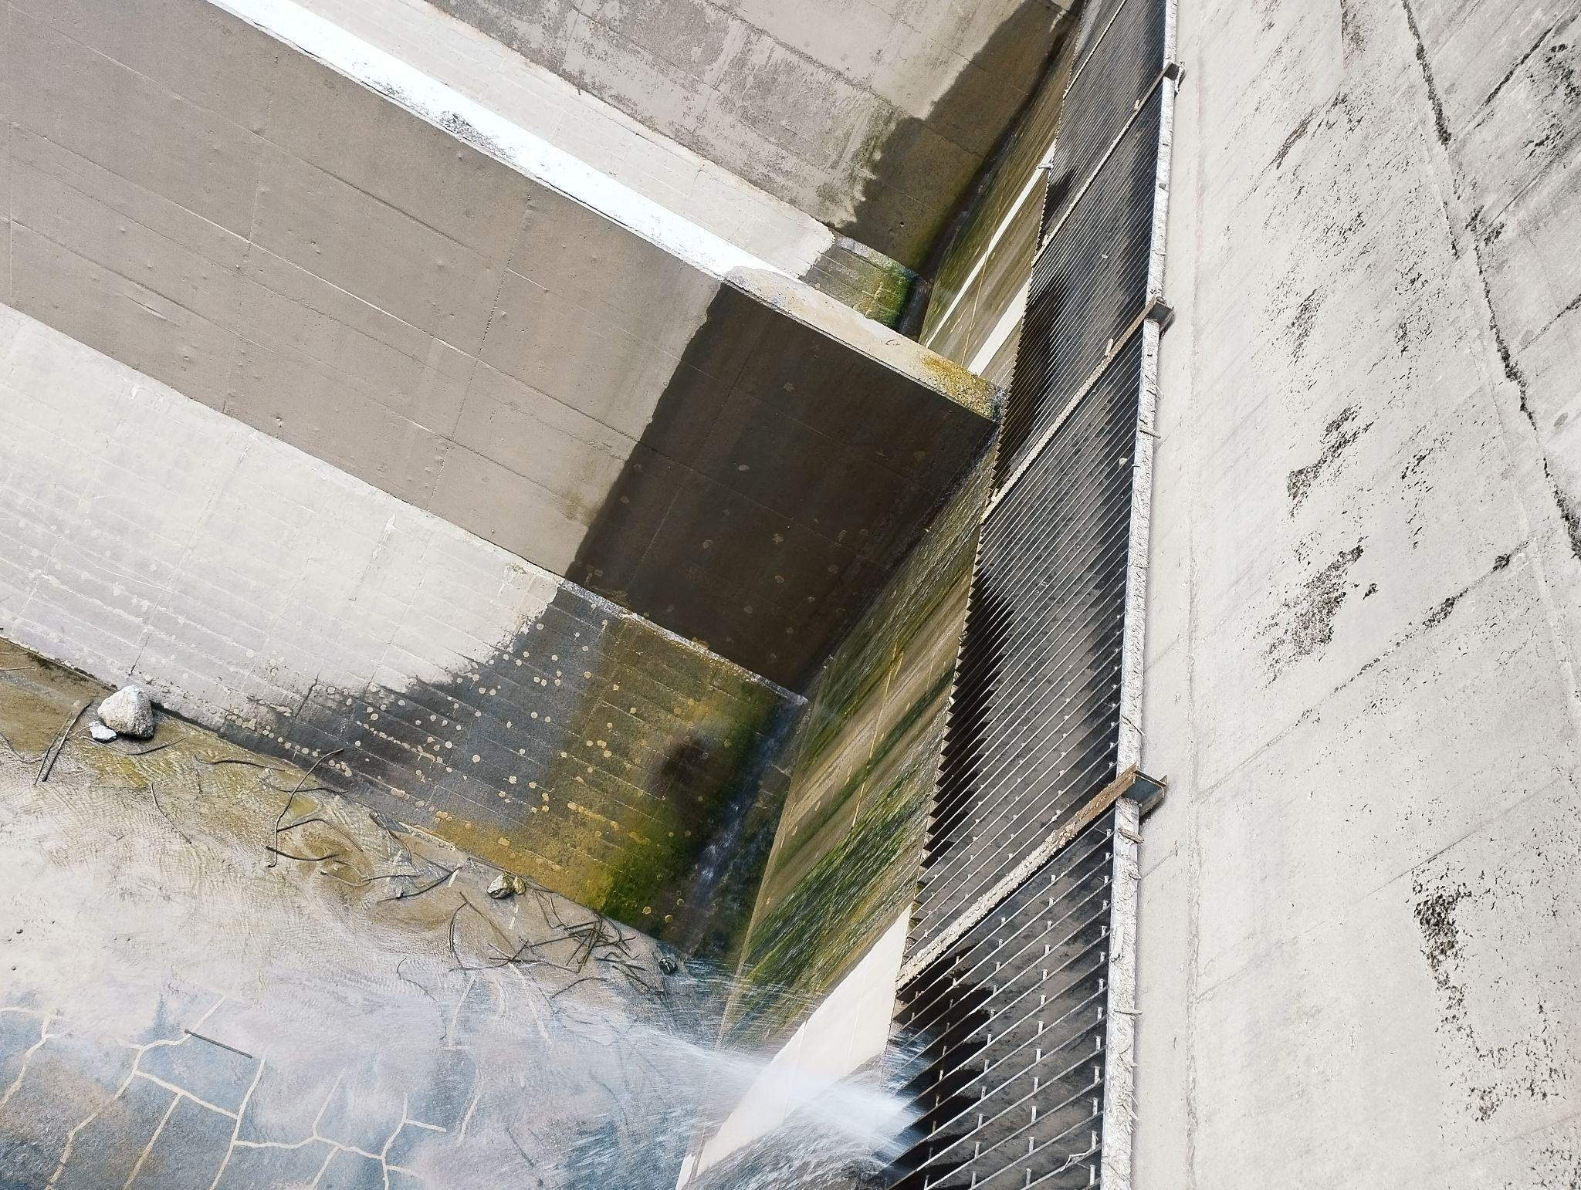
Forebay
Damaged Settling basin

Slide 13
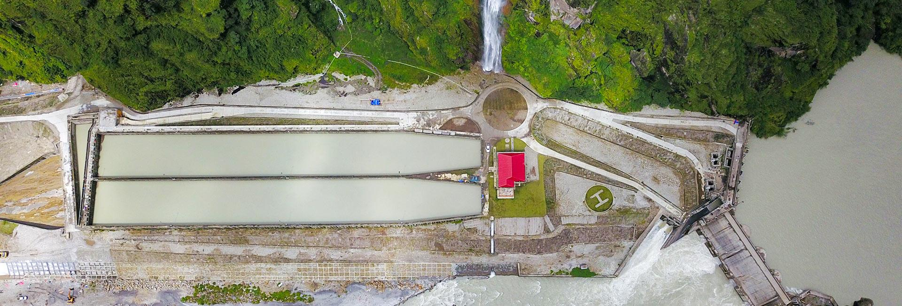
Dam site view

Slide 14
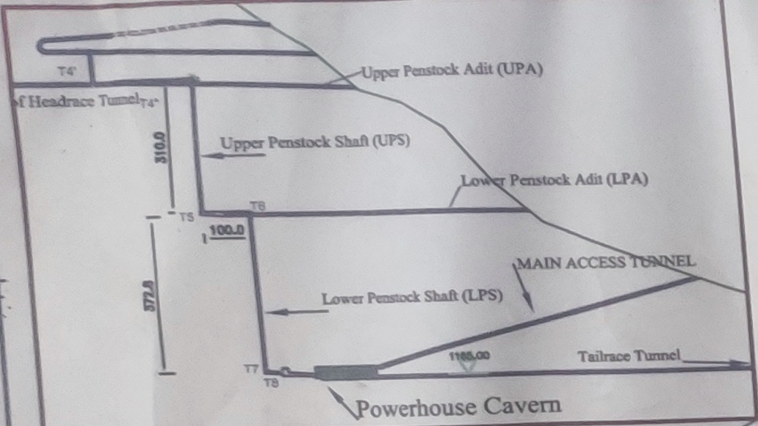
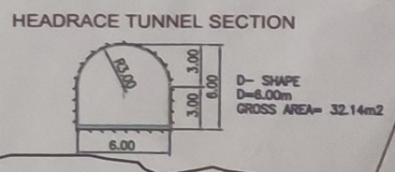
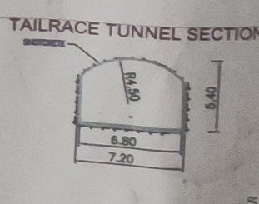
Tunnel Details:
Headrace tunnel: 8.4 km in length, Cross Sectional Area = 32.14 m2
Upper penstock shaft: 310m
Lower penstock shaft: 372m
Main access tunnel: 1185m
Tailrace tunnel: 2.9 km Cross Sectional Area = 35.0 m2
There is also surge tunnel and upper penstock tunnel adit and lower penstock tunnel adit as shown in the fig along side

Slide 15
Power House Details
Divided into 4 main floors:
Machine Hall floor: Consists of Transformers, Protection system,GIS substation and control room
Generator floor: 6 unit of 90 MVA generator is installed.
Turbine floor: 6 unit of Pelton Turbine is installed
MIV(main inlet valve) floor: Consists of the penstock access to the turbine through Inlet valve
Along with this It also consists of a floor with cooling system tank and outlet room for parallel operation of single phase transformers.

Slide 16
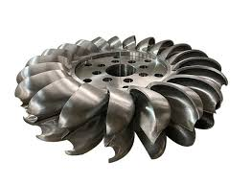
Turbine Details:
Here, pelton turbines are used.
A Pelton turbine (also called a Pelton wheel) is an impulse turbine designed for high-head, low-flow hydro power plants.
No of Unit= 6
Here, each turbine is rotated by 5 nozzle connected to main inlet valve of each unit.
Corrosion of the turbine was observed because of small slit particle present in the water through turbine.

Slide 17
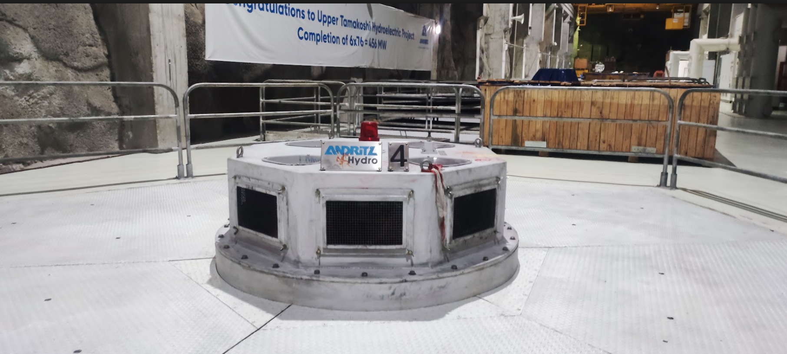
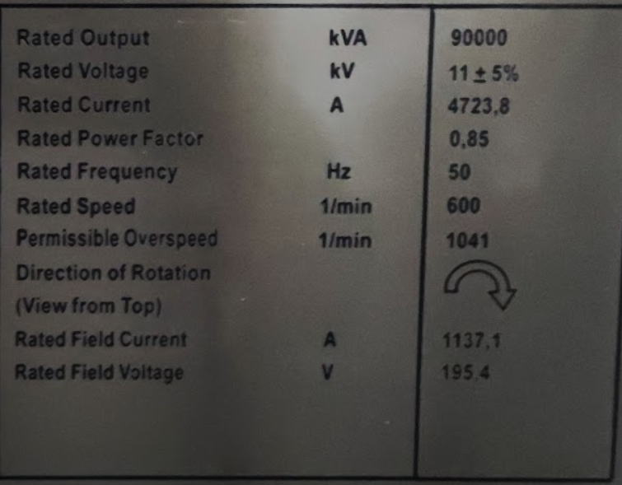
Generator Details:
Type: 3 phase synchronous
Generator
No of unit: 6
Rating: 90 MVA ( 76 MW)
Rated speed: 600 RPM
No of poles: 10
Rated Voltage: 11 kv
Total capacity of 6 unit: (6*76)=456 MW
Type of Earthing : Resistance transformer Earthing

Slide 18
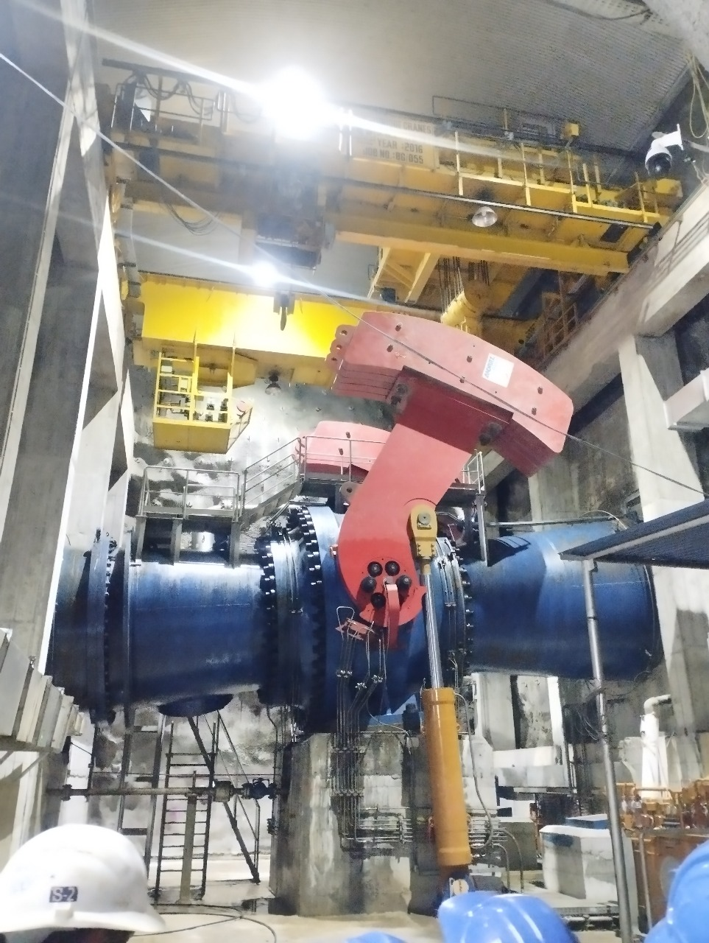
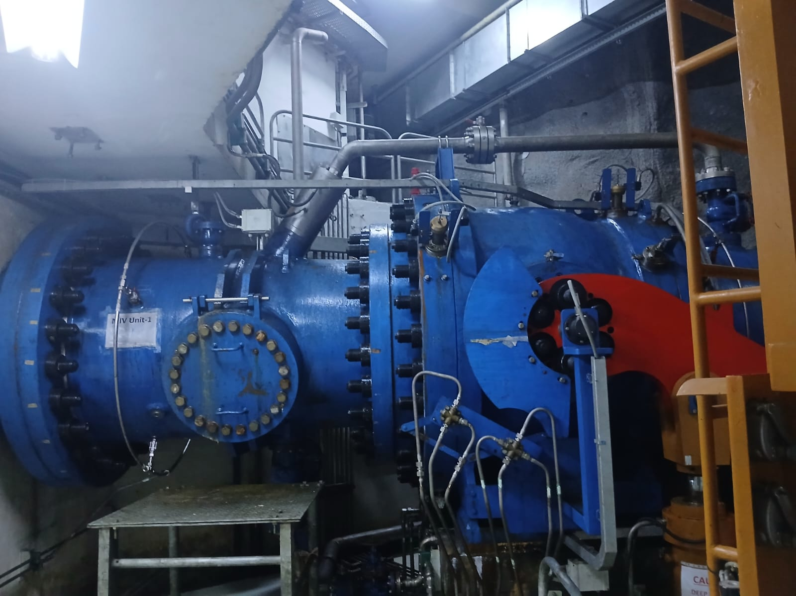
Main Inlet Valve In the Power House
Primary Inlet Valve (Mostly open)
Inlet Valve to the turbine(closed for maintenance of turbine)

Slide 19
Excitation System : Starting Sequence
Battery bank along with diesel generator is kept as a backup for excitation purpose in case of complete shut down of the plant.
The starting sequence is as follow:
1.Pre-start Check: Ensure that all the mechanical and electrical components are in proper condition
2.Battery and DC supply verification
3.Exciter field circuit closure
4.Voltage Build Up
5.Generator frequency and phase matching with the grid
6.Connection to grid
7.Load acceptance

Slide 20
Breaking/ Stop Sequence
600 rpm - Standstill condition
After rotor speed 550 rpm
Electrical break - reduces speed to 300 rpm
Mechanical Break - 0 rpm

Slide 21
Cooling System and Fire Hazard Prevention:
Closed Loop Water cooling system is used in this hydropower plant for cooling of bearing, shaft, generator. Here, river water is used for cooling closed loop water as heat exchanger.
For fire hazard protection, one water tank is available there at top floor which provides water supply in case of any fire attacks.The system is also fitted with automatic sprinkler system with sensors for the automation during any hazard safeguarding the plant from human errors.

Slide 22
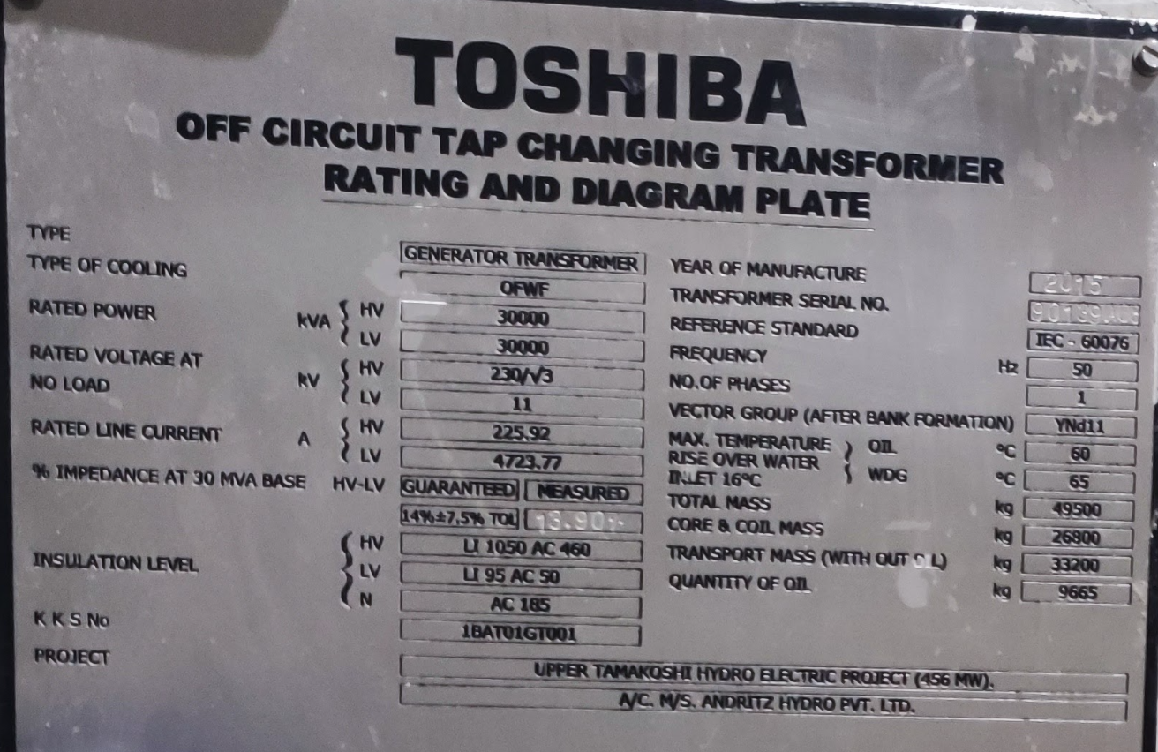
Power Transformer Details:
Transforme Type: Single phase step up transformer
Three single phase transformer is used to form three phase transformer bank to obtain three phase output for transmission
Total Unit: 19
18 in use 1 spare
Power Rating: 30 MVA
3 transformer makes: 90 MVA
Voltage Rating: 11/230KV
Manufacturing year: 2015
Station Service Transformer
670 KVA SST was used, with voltage level 11000/330 v

Slide 23
Substation Details
GIS( Gas Insulated Substation) is installed in the machine floor of the power house, which consists of all the switchgear required for the protection of the generator, transformers, busbars and overall plant.
Double Bus Single Breaker Bus Bar has been used. Double circuit XLPE cable of 220 kv has been taken out for transmission through access tunnel.
The 220 kv transmission line is being transmitted to the Khimti Substation from where it is connected to the national grid.

Slide 24
Protection System
Digital Protection system was used for the protection of the overall plant. Digital relay integrated with the SCADA ensures the protection of the substation , generator and transformers in the plant.
Overall safety of the system is further enhanced with the help of redundant systems. This method ensures the system to run flawlessly even in the case of some equipment failure due to the availability of redundant systems.

Slide 25
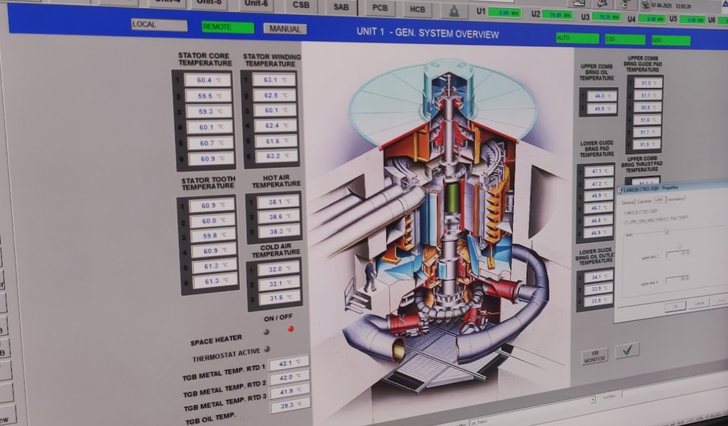
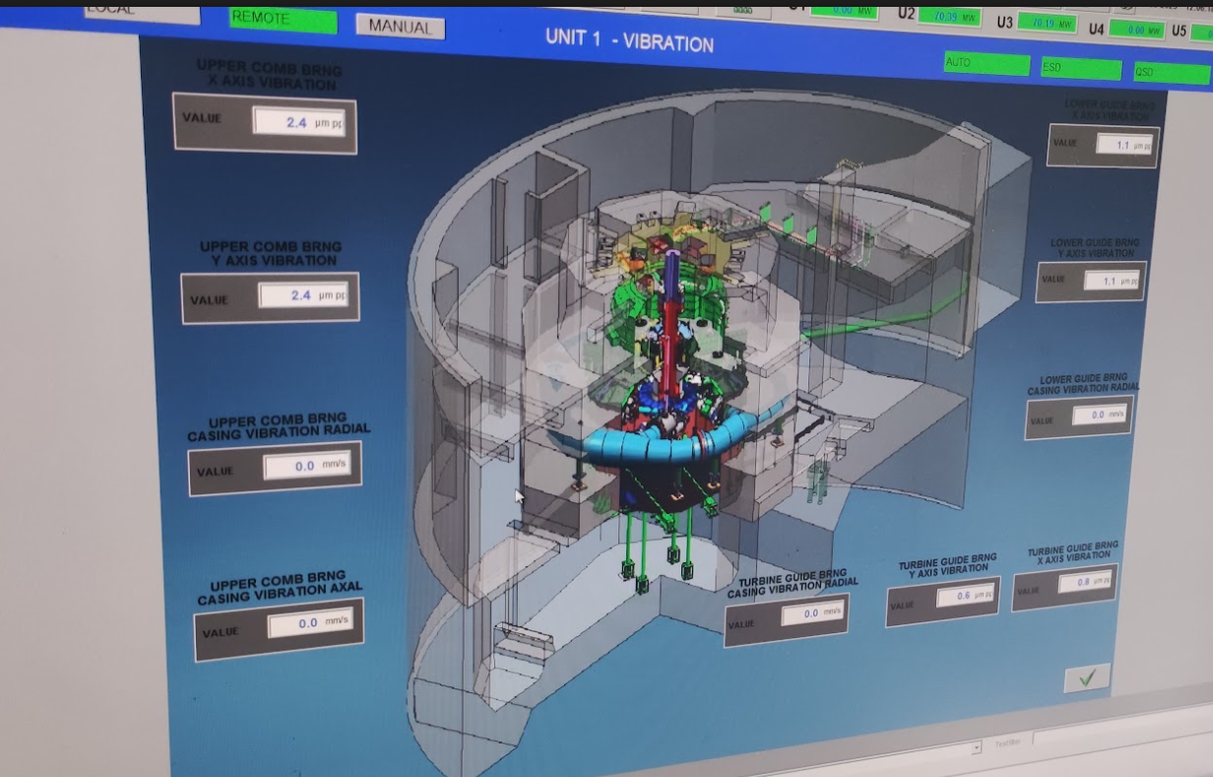
Condition Monitoring System
Continuous monitoring of the temperature and vibration is done remotely using SCADA. Monitoring of Coil temperature of generator, transformer and vibration of turbine and generator helps in deciding the proper condition of their operation and mitigate any fault as soon as possible.

Slide 26
Communication System & SCADA
There are 3 communication system used in this power plant.
Walkie Talkie(Radio communication)
Fibre optics communication(SCADA Communication)
Nepal Telecom Communication(External Communication) Communication with LDC (Load Dispatch Center)
SCADA means Supervisory Control and Data Acquisition.The SCADA system is an advanced control and monitoring system used in hydropower plants to manage and automate operations. It allows operators to remotely monitor, control, and collect real-time data from various components.Fiber optics has been used for the function of SCADA system in the plant.

Slide 27
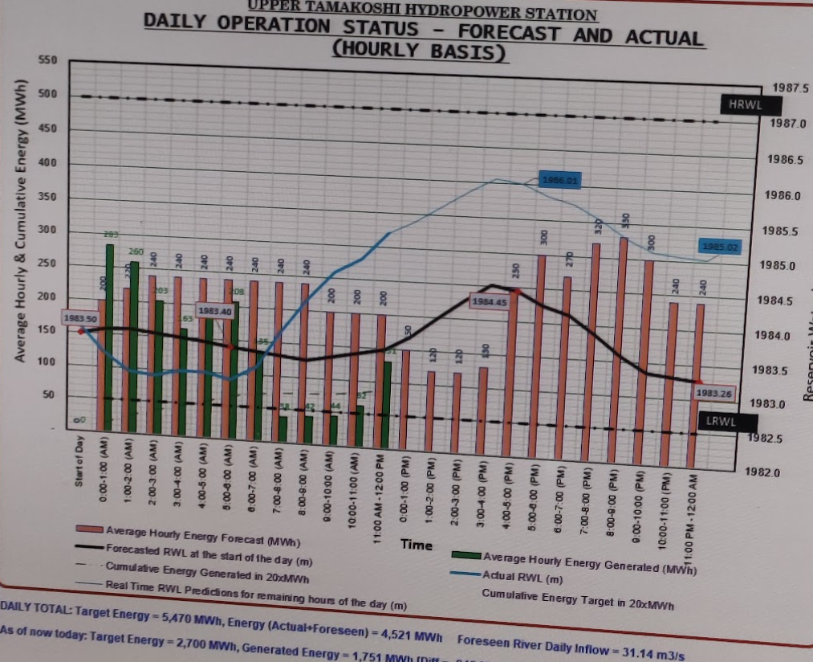
Daily Load Forecasting Curve

Slide 28
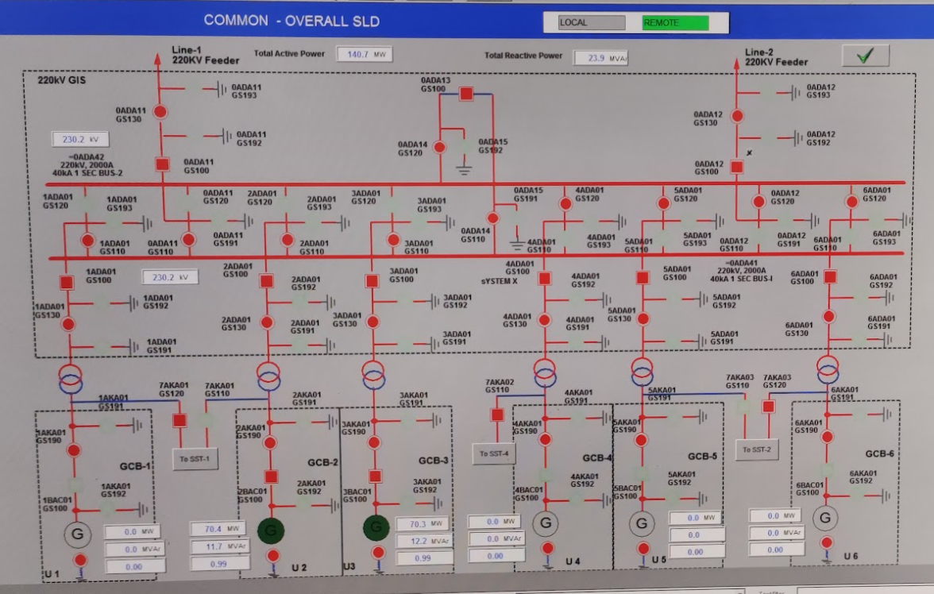
Overall Plant single line diagram

Slide 29
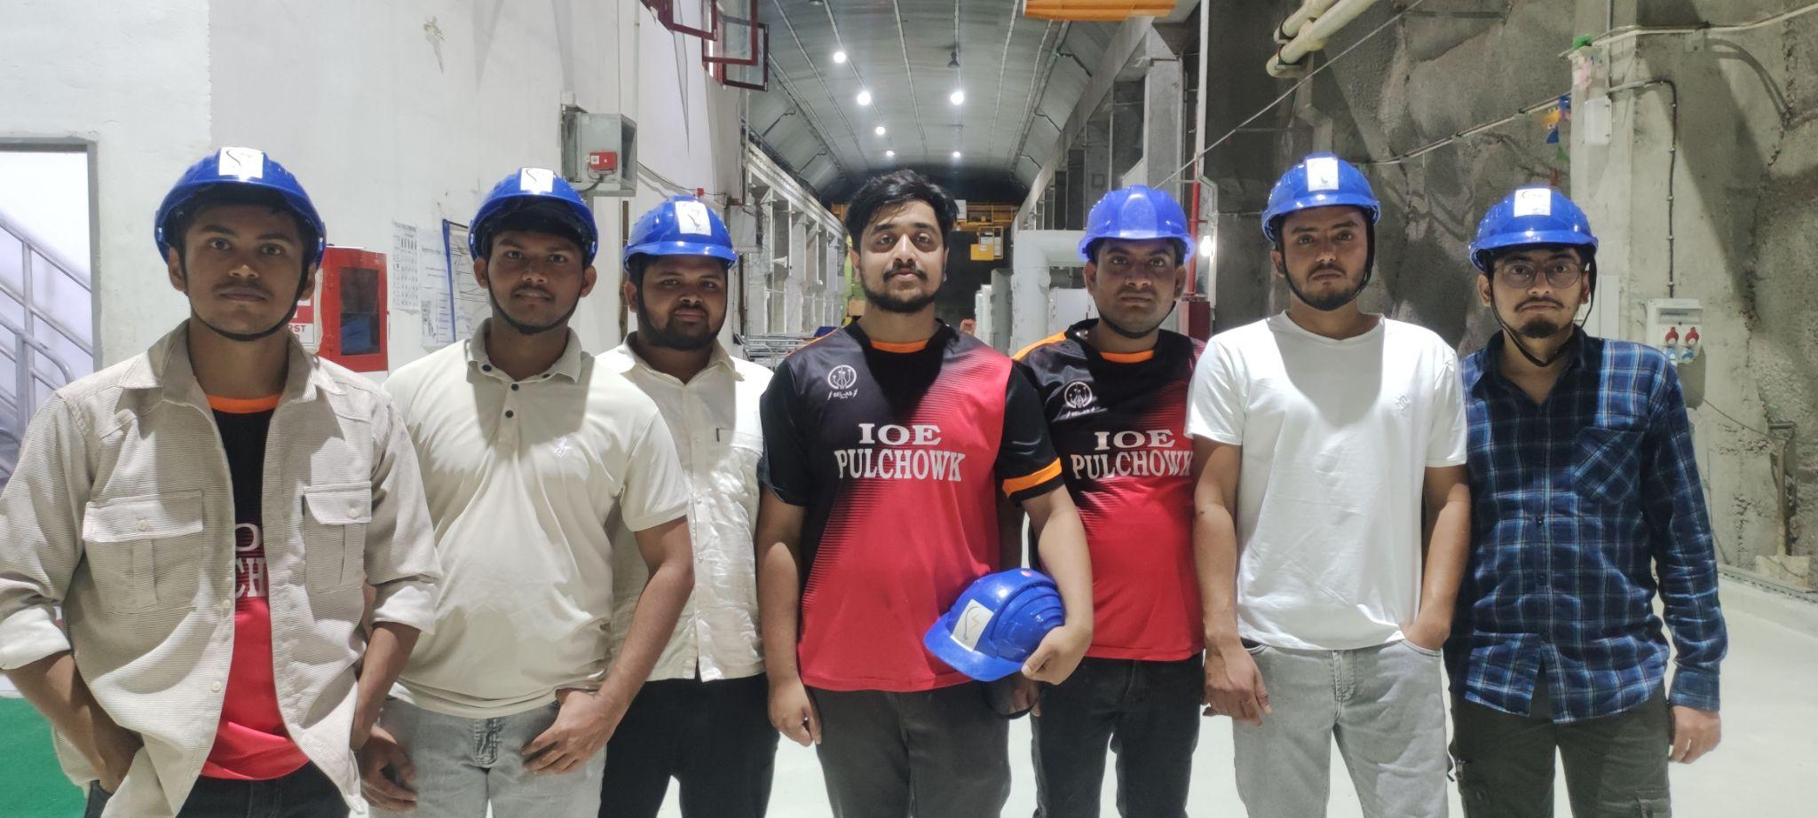
Visit Photos

Slide 30
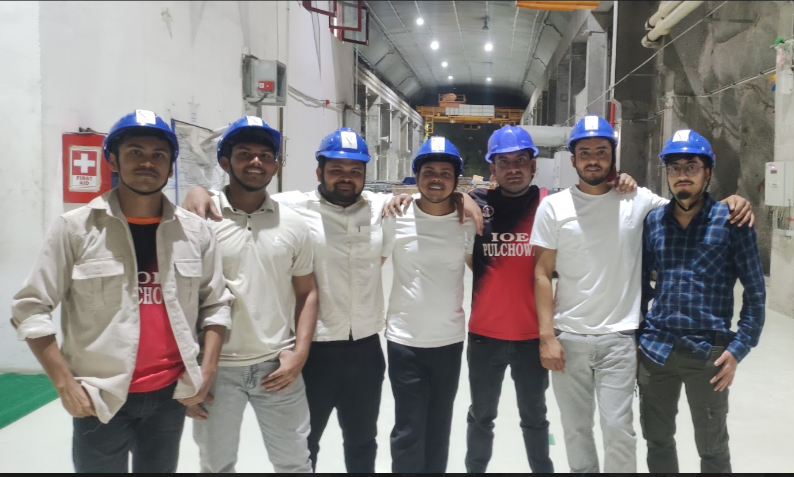
Visit Photos

